Slide 1
Unit Number: II
Unit Name: Layered Architecture
TOPICS:
1) Layers
2) Protocols and Services
3) ISO/OSI Reference Model
4) Overview of TCP/IP Architecture
5) Application Protocols
6) TCP/IP Utilities
Allotted Hours: 06

Slide 2
Networks are complex!
many “pieces”:
hosts
routers
links of various media
applications
protocols
hardware, software
Question:
Is there any hope of organizing
structure of network?
Or at least our discussion of
networks?

Slide 3
Layers of a Network
ticket (purchase)
baggage (check)
gates (load)
runway takeoff
airplane routing
ticket (complain)
baggage (claim)
gates (unload)
runway landing
airplane routing
airplane routing
- a series of steps

Slide 4
Organization of air travel: a different view
ticket (purchase)
baggage (check)
gates (load)
runway takeoff
airplane routing
ticket (complain)
baggage (claim)
gates (unload)
runway landing
airplane routing
airplane routing
Layers: each layer implements a service via its own internal-layer actions relying on services provided by layer below.

Slide 5
Network Architecture
Modern computer networks are designed in a highly structured way.
Protocol Hierarchies
To reduce their design complexity, most networks are organized as a series of layers or levels, each one built upon its predecessor.
The number of layers, name, content, and function of each layer differs from network to network.

Slide 6
In all networks, the purpose of each layer is to offer certain services to the higher layers, shielding those layers from details of how the offered services are actually implemented.
Layer n on one machine carries on a conversation with layer n on another machine.
The rules and conventions used in this conversation are collectively known as the Layer n protocol.

Slide 7
The entities comprising the corresponding layers on different machines are called peer processes.
It is the peer processes that communicate using the protocol.
In reality, no data are directly transferred from layer n on one machine to layer n on another machine.

Slide 8
Instead, each layer passes data and control information to the layer immediately below it, until the lowest layer is reached.
Below layer 1 is the physical medium through which the actual communication occurs.
Between each pair of adjacent layers there is an interface.
Interface: Defines which primitive operations and services the lower layer offers to the upper one.

Slide 10
Defining clean interfaces between layers - Requires each layer perform a specific collection of well-understood functions.
Minimizing the amount of information that must be passed between layers
Make it simpler to replace the implementation of one layer with a completely different implementation.

Slide 11
The set of layers and protocols is called the Network Architecture.
The specification of the architecture must contain enough information to allow an implementer to write the program or build the hardware for each layer so that it correctly obeys the appropriate protocol.

Slide 12
Design Issues for Layers
Every layer must have a mechanism for connection establishment.
Multiple processes – Process to Process Communication.
Multiple destinations – Need addressing mechanisms
2. Mechanisms for terminating the connections.

Slide 13
3. Data Transfer Rules:
Simplex Communication
Half-duplex Communication
Full-duplex Communication
The protocol must also determine the number of logical channels per connection along with their individual priorities.

Slide 14
Error Control Mechanisms
5. Message Ordering
6. Fast sender swamping a slow receiver with data. (solutions
have some kind of feedback mechanisms).

Slide 15
Inability of all processes to accept arbitrarily long messages – Mechanisms for disassembling, transmitting and then reassembling messages.
8. Setting up a separate connection for each pair of
communicating processes - Multiplexing and de-multiplexing
done transparently.
9. Multiple paths between source and destination - This
decision may be split over two or more layers.

Slide 16
OSI Reference Model: An Overview
The layered model that dominated data communications and networking literature before 1990 was the Open Systems Interconnection (OSI) model.
The TCP / IP protocol suite became the dominant commercial architecture because it was used and tested extensively in the Internet; the OSI model was never fully implemented.

Slide 17
ISO: (International Standards Organization)
- A multinational body established in 1947
- Dedicated to worldwide agreement on International
standards.
An ISO standard that covers all aspects of network communications is the OSI model, which was first introduced in 1970s.

Slide 18
Open System: A set of protocols that allows any two different systems to communicate regardless of their underlying architecture.
Purpose of OSI Model: It shows how to facilitate communication between different systems without requiring changes to the logic of underlying hardware and software.

Slide 19
Not a protocol
Model for understanding and designing a network architecture that is flexible, robust, and interoperable.
A layered framework for the design of network systems that allows communication between all types of computer systems.

Slide 20
Consists of seven separate but related layers, each of which defines a part of the process of moving information across a network.

Slide 21
This lecture introduces the ISO-OSI layered architecture of Networks.
According to the ISO standards, networks have been divided into 7 layers depending on the complexity of the functionality each of these layers provide.
The detailed description of each of these layers is given in the notes below.
We will first list the layers as defined by the standard in the increasing order of function complexity:

Slide 22
7 Layers of ISO OSI Model
Physical Layer
Data Link Layer
Network Layer
Transport Layer
Session Layer
Presentation Layer
Application Layer

Slide 23
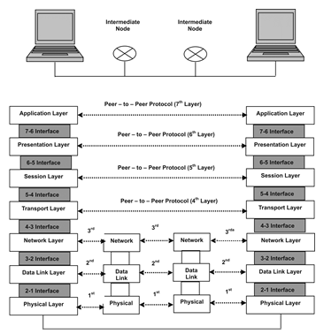
7 Layers of OSI Model

Slide 24
As the message travels from one device to another, it may pass through several intermediate nodes or devices.
These intermediate nodes or devices usually involve only the first three layers of the OSI model.
Each layer defines a family of functions distinct from those of the other layers.

Slide 25
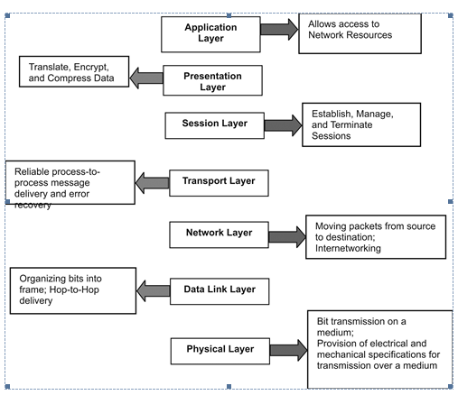
Summary of OSI Model

Slide 26
Physical Layer
Lowest layer in the OSI model.
Helps in transmission of data between two machines communicating through a physical medium
Examples: (Physical Media) Optical fibres, copper wire or wireless etc.

Slide 27
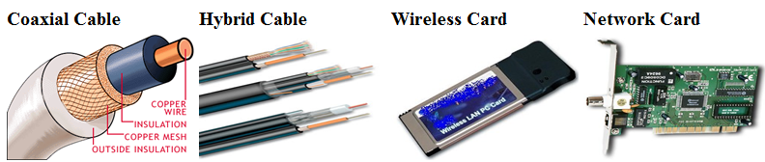
Main functions (Physical Layer):
1) Hardware Specification: The details of the physical cables, network interface cards, wireless radios, etc. are a part of this layer.

Slide 28
2) Encoding and Signalling:
How are the bits encoded in the medium?
Example: On the copper wire medium, we can use different voltage levels for a certain time interval to represent '0' and '1'. We may use +5mV for 1nsec to represent '1' and -5mV for 1nsec to represent '0'.
All the issues of modulation is dealt with in this layer.
Example: We may use Binary phase shift keying for the representation of '1' and '0' rather than using different voltage levels if we have to transfer in RF waves.
Notes:
BPSK: BPSK (also sometimes called PRK, Phase Reversal Keying, or 2PSK) is the simplest form of phase shift keying (PSK).
It uses two phases which are separated by 180° and so can also be termed 2-PSK.
It does not particularly matter exactly where the constellation points are positioned, and in this figure they are shown on the real axis, at 0° and 180°.
This modulation is the most robust of all the PSKs since it takes the highest level of noise or distortion to make the demodulator reach an incorrect decision.
It is, however, only able to modulate at 1 bit/symbol and so is unsuitable for high data-rate applications when bandwidth is limited.
In the presence of an arbitrary phase-shift introduced by the communications channel, the demodulator is unable to tell which constellation point is which.
As a result, the data is often differentially encoded prior to modulation.

Slide 29
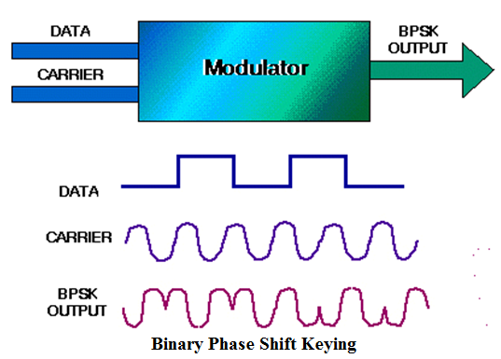
BPSK – Binary Phase Shift Keying - Diagram

Slide 30
3) Data Transmission and Reception:
The transfer of each bit of data is the responsibility of this layer.
This layer assures the transmission of each bit with a high probability.
The transmission of the bits is not completely reliable as their is no error correction in this layer.

Slide 31
4) Topology and Network Design:
The network design is the integral part of the physical layer.
Which part of the network is the router going to be placed?
Where the switches will be used?
Where we will put the hubs?
How many machines is each switch going to handle?
What server is going to be placed where?

Slide 32
and many such concerns are to be taken care of by the physical layer.
The various kinds of topologies that we decide to use may be ring, bus, star or a hybrid of these topologies depending on our requirements.

Slide 33
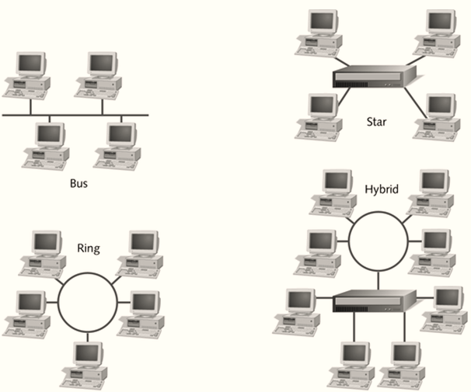
Network Topologies

Slide 34
Data Link Layer
This layer provides reliable transmission of a packet by using the services of the physical layer which transmits bits over the medium in an unreliable fashion.
This layer is concerned with:
Framing: Breaking input data into frames (typically a few hundred bytes) and caring about the frame boundaries and the size of each frame.
Acknowledgment: Sent by the receiving end to inform the source that the frame was received without any error.

Slide 35
Error Detection: The frames may be damaged, lost or duplicated leading to errors. The error control is on link to link basis.
Retransmission: The packet is retransmitted if the source fails to receive acknowledgment.
Flow Control: Necessary for a fast transmitter to keep pace with a slow receiver.

Slide 36
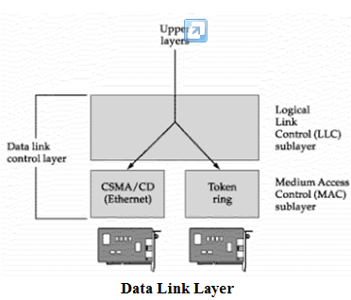

Slide 37
Network Layer
Its basic functions are Routing and Congestion Control. Routing: This deals with determining how packets will be routed (transferred) from source to destination.
It can be of three types:
Static: Routes are based on static tables that are "wired into" the network and are rarely changed.

Slide 38
Dynamic: All packets of one application can follow different routes depending upon the topology of the network, the shortest path and the current network load.
Semi-Dynamic: A route is chosen at the start of each conversation and then all the packets of the application follow the same route.

Slide 39
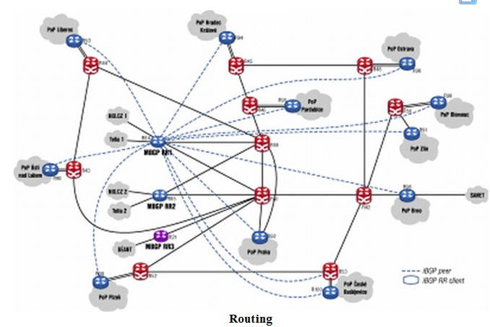
A Sample Routing Diagram

Slide 40
The services provided by the network can be of two types :
Connection less service: Each packet of an application is treated as an independent entity. On each packet of the application the destination address is provided and the packet is routed.

Slide 41
Connection oriented service: Here, first a connection is established and then all packets of the application follow the same route. To understand the above concept, we can also draw an analogy from the real life. Connection oriented service is modeled after the telephone system.

Slide 42
Congestion Control: A router can be connected to 4-5 networks.
The control of such congestion is also a function of the network layer.
Other issues related with this layer are:
Transmission time
Delays
Jittering

Slide 43
Internetworking:
Multiple networks that act as one large network
Connected by networking hardware such as routers, switches, and bridges.
A solution born of three networking problems:
Isolated LANs,
Duplication of resources, and
Lack of a centralized network management system.

Slide 44
Network Layer does not guarantee that the packet will reach its intended destination. There are no reliability guarantees.

Slide 45
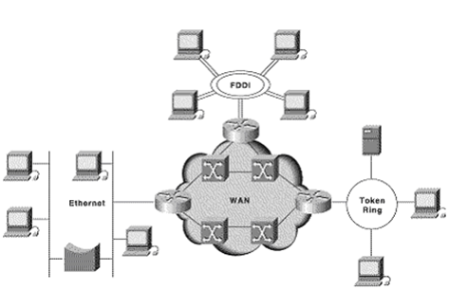
Internetworking

Slide 46
Transport Layer
Multiplexing / Demultiplexing : Normally the transport layer will create distinct network connection for each transport connection required by the session layer.
The transport layer may either create multiple network connections (to improve throughput) or it may multiplex several transport connections onto the same network connection (because creating and maintaining networks may be expensive).

Slide 47
Demultiplexing will be required at the receiving end.
A point to note here is that communication is always carried out between two processes and not between two machines.
This is also known as process-to-process communication.
Fragmentation and Re-assembly

Slide 48
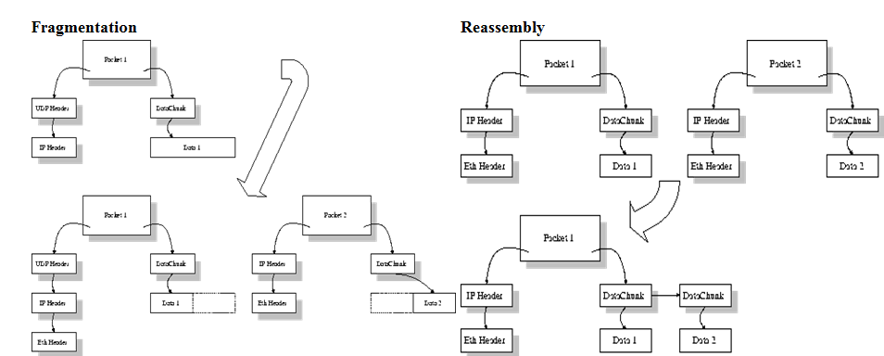

Slide 49
Types of service : The service may be perfectly reliable, or may be reliable within certain tolerances or may not be reliable at all.
The message may or may not be received in the order in which it was sent.
The decision regarding the type of service to be provided is taken at the time when the connection is established.

Slide 50
Error Control : If reliable service is provided then error detection and error recovery operations are also performed.
It provides error control mechanism on end to end basis.

Slide 51
Flow Control : A fast host cannot keep pace with a slow one. Hence, this is a mechanism to regulate the flow of information.
Connection Establishment / Release : The transport layer also establishes and releases the connection across the network.
This requires some sort of naming mechanism so that a process on one machine can indicate with whom it wants to communicate.

Slide 52
Session Layer
It deals with the concept of Sessions i.e. when a user logins to a remote server he should be authenticated before getting access to the files and application programs.
Establish and maintain sessions.
The session layer re-establishes the connection if the session breaks down.

Slide 53
It also ensures that the data transfer starts from where it breaks keeping it transparent to the end user.
Example: In case of a session with a database server, this layer introduces check points at various places so that in case the connection is broken and re-established, the transition running on the database is not lost even if the user has not committed.
This activity is called Synchronization.
Another function of this layer is Dialogue Control which determines whose turn is it to speak in a session. It is useful in video conferencing.

Slide 54
Another function of this layer is Dialogue Control which determines whose turn is it to speak in a session. It is useful in video conferencing.

Slide 55
Presentation Layer
Concerned with the syntax and semantics of the information transmitted.
Data structures to be exchanged can be defined in abstract way along with standard encoding.
It also manages these abstract data structures and allows higher level of data structures to be defined an exchange.
It encodes the data in standard agreed way (network format).

Slide 56
Suppose there are two machines A and B one follows 'Big Endian' and other 'Little Endian' for data representation. This layer ensures that the data transmitted by one gets converted in the form compatible to other machine. This layer is concerned with the syntax and semantics of the information transmitted.
In order to make it possible for computers with different data representations to communicate data structures to be exchanged can be defined in abstract way alongwith standard encoding. It also manages these abstract data structres and allows higher level of data structres to be defined an exchange. Other functions include compression, encryption etc.

Slide 57
A

Slide 58
A

Slide 59
Application Layer
The seventh layer contains the application protocols with which the user gains access to the network. The choice of which specific protocols and their associated functions are to be used at the application level is up to the individual user. Thus the boundary between the presentation layer and the application layer represents a separation of the protocols imposed by the network designers from those being selected and implemented by the network users.
For example commonly used protocols are HTTP(for web browsing), FTP(for file transfer) etc.

Slide 60
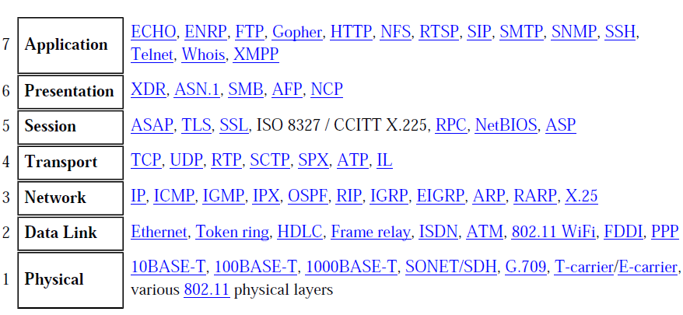
Components of ISO/OSI Model

Slide 61
A

Slide 62
Network Layers as in Practice
In most of the networks today, we do not follow the OSI model of seven layers. What is actually implemented is as follows. The functionality of Application layer and Presentation layer is merged into one and is called as the Application Layer.

Slide 63
A

Slide 64
Functionalities of Session Layer is not implemented in most networks today. Also, the Data Link layer is split theoretically into MAC (Medium Access Control) Layer and LLC (Link Layer Control).
But again in practice, the LLC layer is not implemented by most networks. So as of today, the network architecture is of 5 layers only.

Slide 65
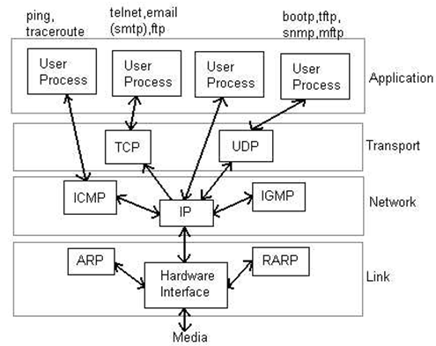
Network Layers in Internet

Slide 66
The TCP/IP model or Internet reference model, sometimes called the DoD model (DoD, Department of Defense), ARPANET reference model, is a layered abstract description for communications and computer network protocol design.
Created in the 1970s by DARPA for use in developing the Internet's protocols, and the structure of the Internet is still closely reflected by the TCP/IP model.
It has fewer, less rigidly defined layers than the commonly referenced OSI model, and thus provides an easier fit for real-world protocols.

Slide 67
No document officially specifies the model
Different names are given to the layers by different documents
Different numbers of layers are shown by different documents
There are versions of this model with four layers and with five layers
The original four-layer version of the model has:

Slide 68
Layer 4 - Process Layer or Application Layer: This is where the "higher level" protocols such as SMTP, FTP, SSH, HTTP, etc. operate.
Layer 3 - Host-To-Host (Transport) Layer: This is where flow-control and connection protocols exist, such as TCP. This layer deals with opening and maintaining connections, ensuring that packets are in fact received.

Slide 69
Layer 2 - Internet or Internetworking Layer: This layer defines IP addresses, with many routing schemes for navigating packets from one IP address to another.
Layer 1 - Network Access Layer: This layer describes the physical equipment necessary for communications, such as twisted pair cables, the signalling used on that equipment, and the low-level protocols using that signalling.

Slide 70
In modern text books, the model has evolved into a five-layer version that splits Layer 1 into a Physical layer and a Network Access layer, corresponding to the physical layer and data link layer of the OSI model.
The Internet or Internetworking layer is named Network layer.

Slide 71
Example: (of logical addresses) Consider a part of an internet with 2 routers connecting 3 LANs.
Each device (computer or router) has a pair of addresses (logical and physical) for each connection.
In this case, each computer is connected to only one link and therefore has only one pair of addresses.
Each router is connected to 3 networks.
So each router has 3 pairs of addresses, one for each connection.

Slide 72
Each router must have a separate physical address for each connection, it may not be obvious why it needs a logical address for each connection.
The computer with logical address A and physical address 10 needs to send a packet to the computer with logical address P and physical address 95.
We may use letters to show the logical addresess and numbers for physical addresses, but both are actually numbers.

Slide 73
The sender encapsulates its data in a packet at the network layer and adds 2 logical addresses (A and P).
In most protocols, the logical source address comes before the logical destination address (contrary to the order of physical addresses).
The NL needs to find the physical address of the next hop before the packet can be delivered.

Slide 74
The NL consults its routing table and finds the logical address of the next hop (router 1) to be F.
The ARP finds the physical address of router 1 that corresponds to the logical address of 20.
Now the NL passes this address to the DLL, which in turn, encapsulates the packet with physical destination address 20 and physical source address 10.

Slide 75
The frame is received by every device on LAN1, but is discarded by all except router 1, which finds that the destination physical address in the frame matches with its own physical address .
The router decapsulates the packet from the frame to read the logical destination address P.
Since the logical destination address does not match the router’s logical address, the router knows that the packet needs to be forwarded.

Slide 76
The router consults its routing table and ARP to find the physical destination address of the next hop (router 2), creates a new frame, encapsulates the packet, and sends it to router 2.
Note the physical addresses in the frame.
The source physical address changes from 10 to 99.

Slide 77
The destination physical address changes from 20 (router 1 physical address) to 33 (router 2 physical address) .
The logical source and destination addresses must remain the same; otherwise the packet will be lost.
At router 2 we have a similar scenario. The physical addresses are changed, and a new frame is sent to the destination computer.

Slide 78
When the frame reaches the destination, the packet is decapsulated.
The destination logical address P matches the logical address of the computer.
The data are decapsulated from the packet and delivered to the upper layer.
Note: Although physical addresses will change from hop to hop, logical addresses remain the same from source to destination.

Slide 79
Port Addresses: The IP address and the physical address are necessary for a quantity of data to travel from a source to destination host.
Arrival at the destination host is not the final objective of data communications on the Internet.
A system that sends nothing but data from one computer to another is not complete.

Slide 80
Today, computers are devices that can run multiple processes at the same time.
The end objective of Internet communication is a process communicating with other processes.
For these processes to receive data simultaneously, we need a method to label the different processes. In other words, they need addresses.

Slide 81
In TCP/IP architecture the label assigned to a process is called a port address. A port address in TCP/IP is 16 bits in length.
Specific Addresses: Some applications have user-friendly addresses that are designed for that specific address.
Examples: e-mail address and the URL.
These addresses get changed to the corresponding port and logical addresses by the sending computer.

Slide 82
Address Resolution Protocol:
Used to associate a logical address with a physical address. On a typical physical network, such as a LAN, each device on a link is identified by a physical or station address, usually imprinted on NIC.
Used to find the physical address of the node when its Internet address is known.

Slide 83
RARP:
Allows a host to discover its Internet address when it knows only its physical address.
It is used when a computer is connected to a network for the first time or when a diskless computer is booked.

Slide 84
Internet Control Message Protocol (ICMP):
A mechanism used by hosts and gateways to send notification of datagram problems back to the sender.
It sends query and error reporting messages.

Slide 85
Internet Group Messaging Protocol (IGMP): Used to facilitate the simultaneous transmission of a message to a group of recipients.

Slide 86
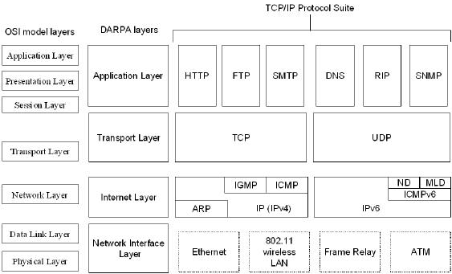

Slide 87
A

